Slide 1

Capture The Flag
Practicum at Samsung R&D Institute Ukraine (SRK)
prepared by Alina Belaya

Slide 2
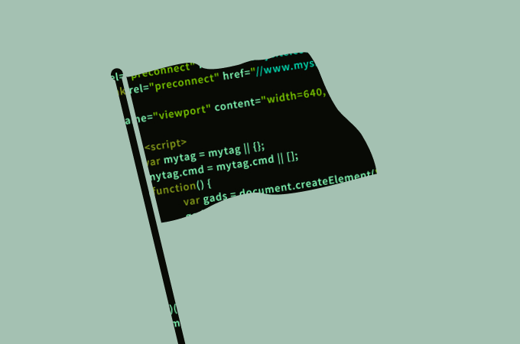
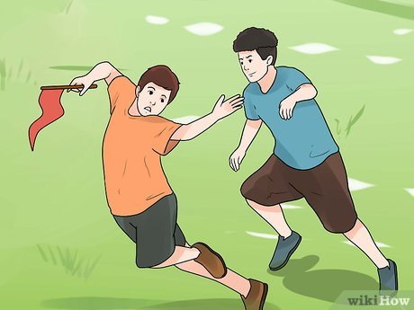
CTF (Capture The Flag) is a kind of information security competition that challenges contestants to solve a variety of tasks. In these challenges, the contestant is usually asked to find a specific piece of text that may be hidden somewhere.
What is CTF
CTFs can be played as an individual or in teams. Also, it`s worth mentioning that CTFs are available to everyone. Many challenges do not require programming knowledge and are simply a matter of problem solving and creative thinking.
The game is based on the traditional outdoor sport of the same name.

Slide 3
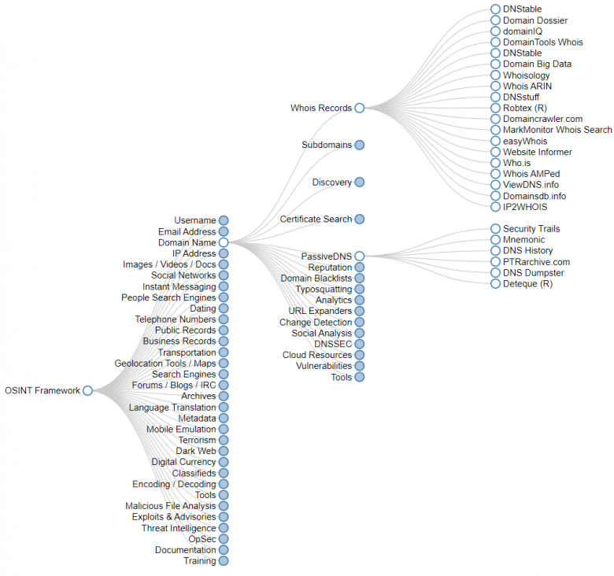
OSINT
Open source intelligence, also known as OSINT, refers to the gathering of information from publicly available sources, such as:
Media
Internet
Public government data
Professional and academic publications
Commercial data
Grey literature

Slide 4
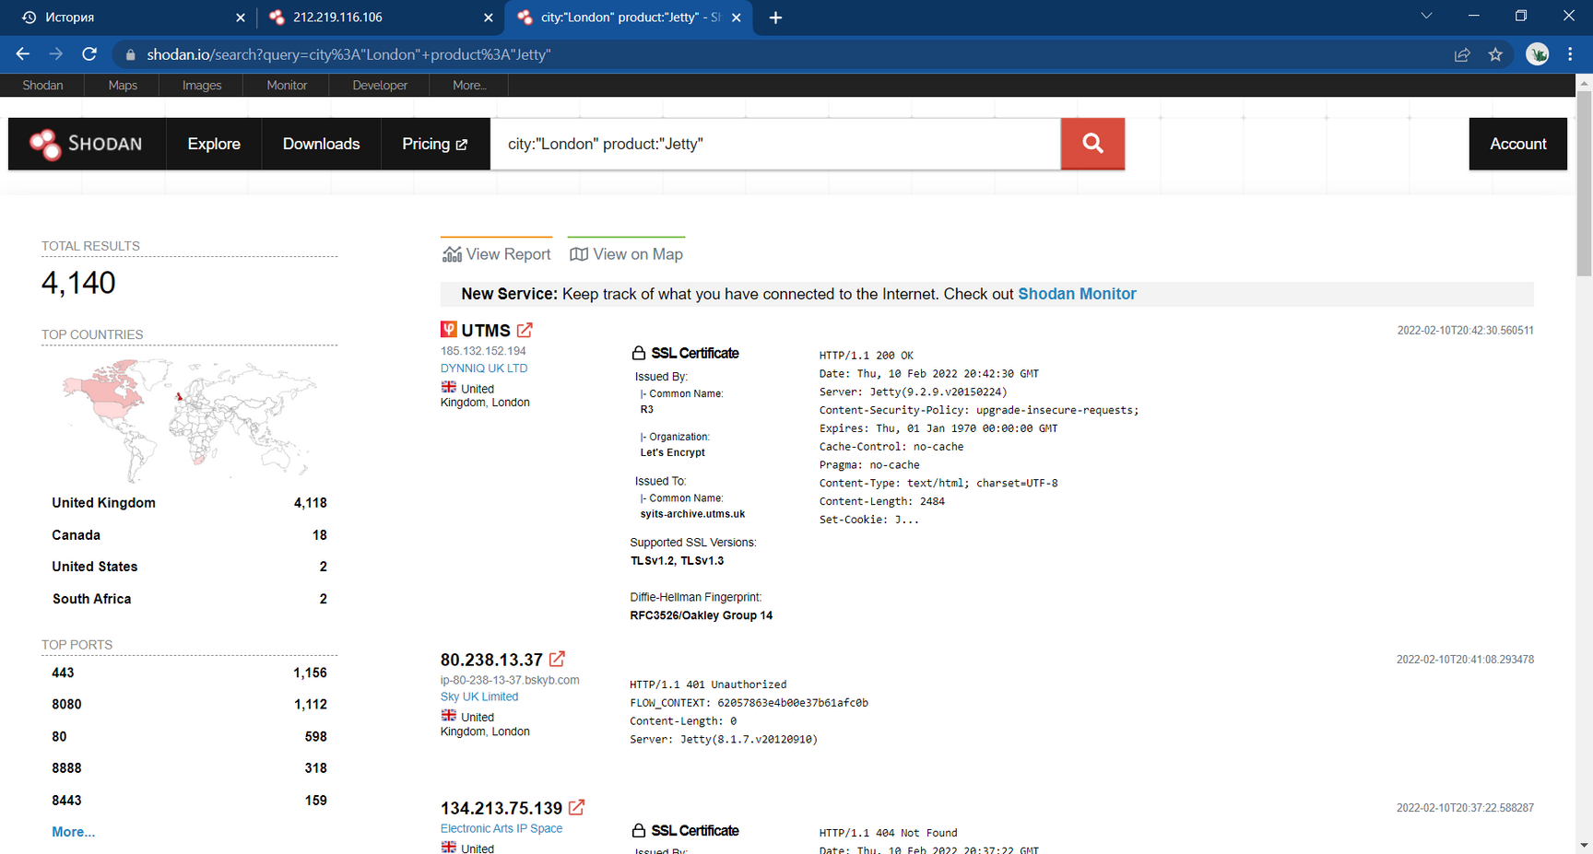
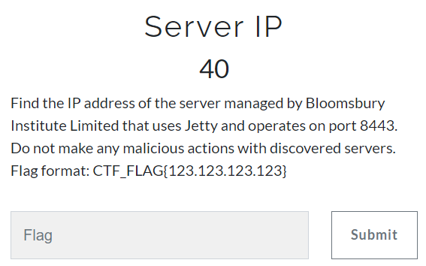

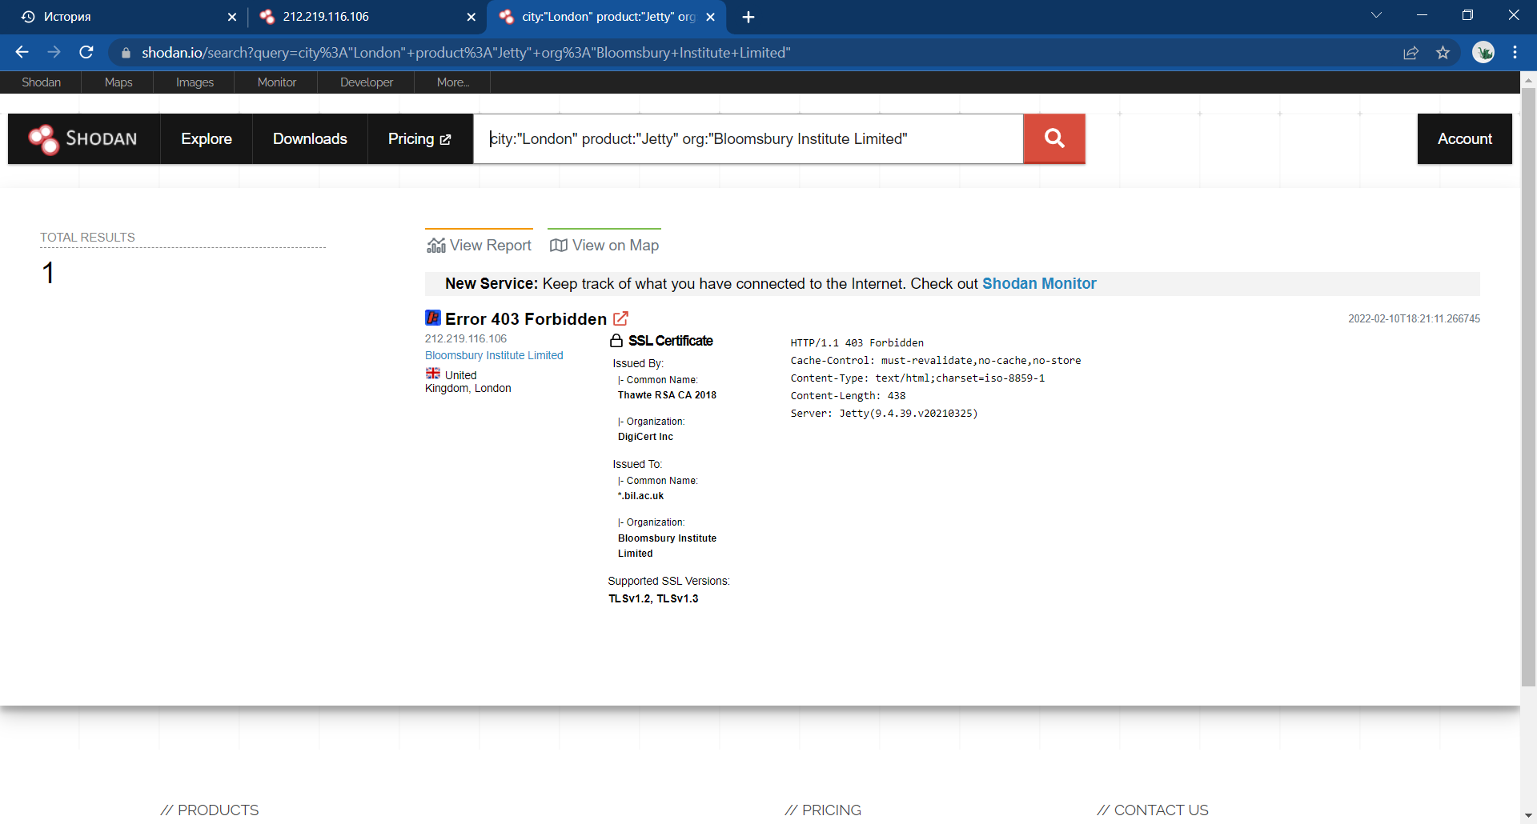

Server IP
OSINT

Slide 5
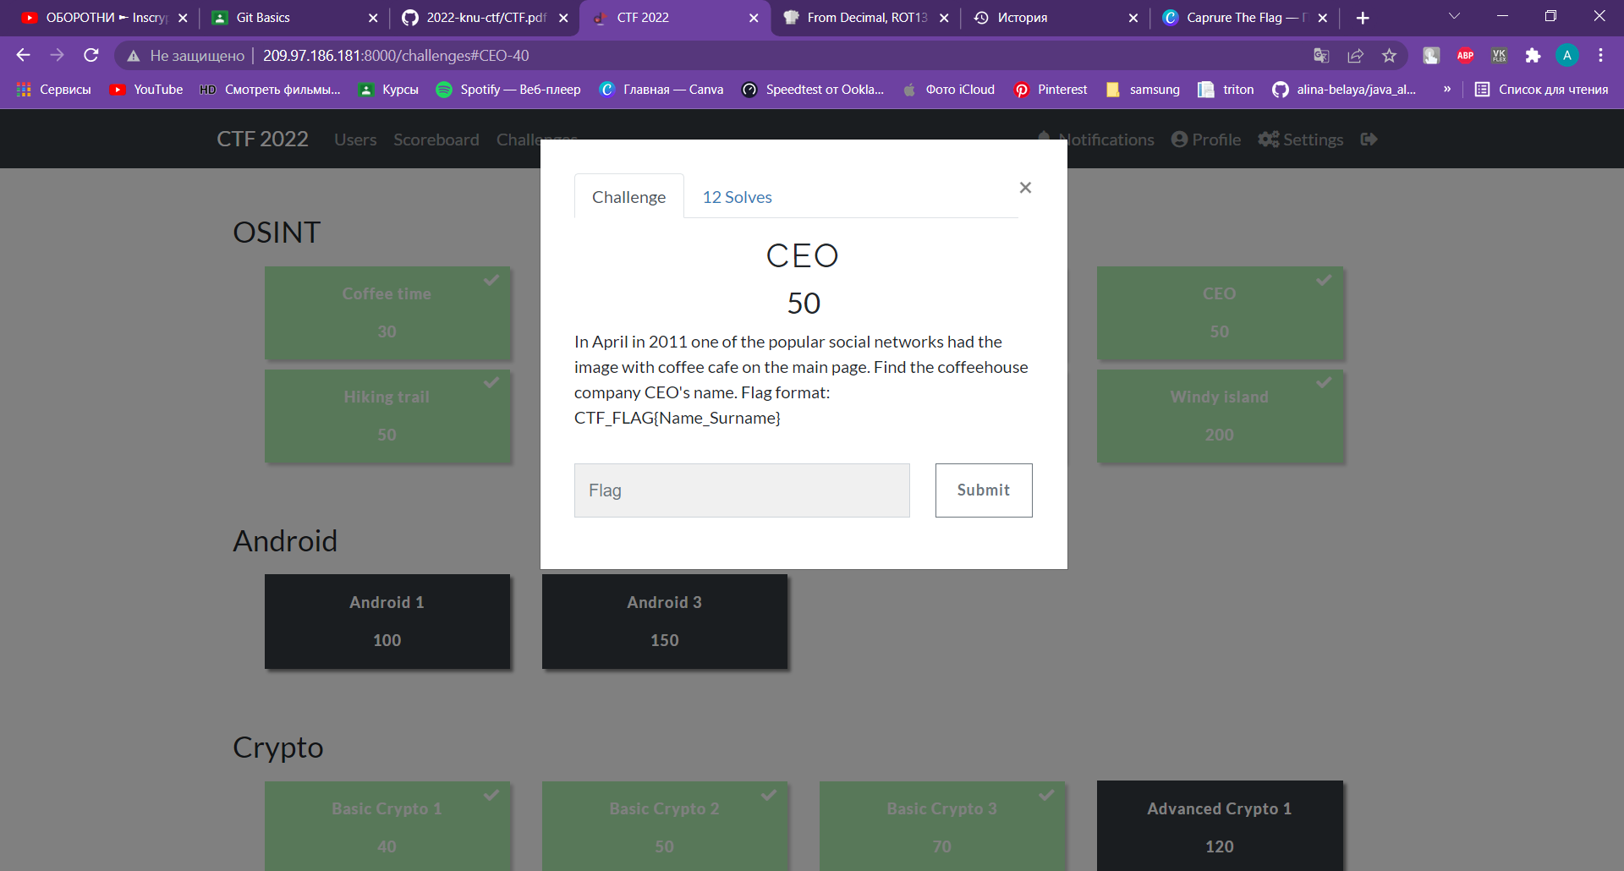
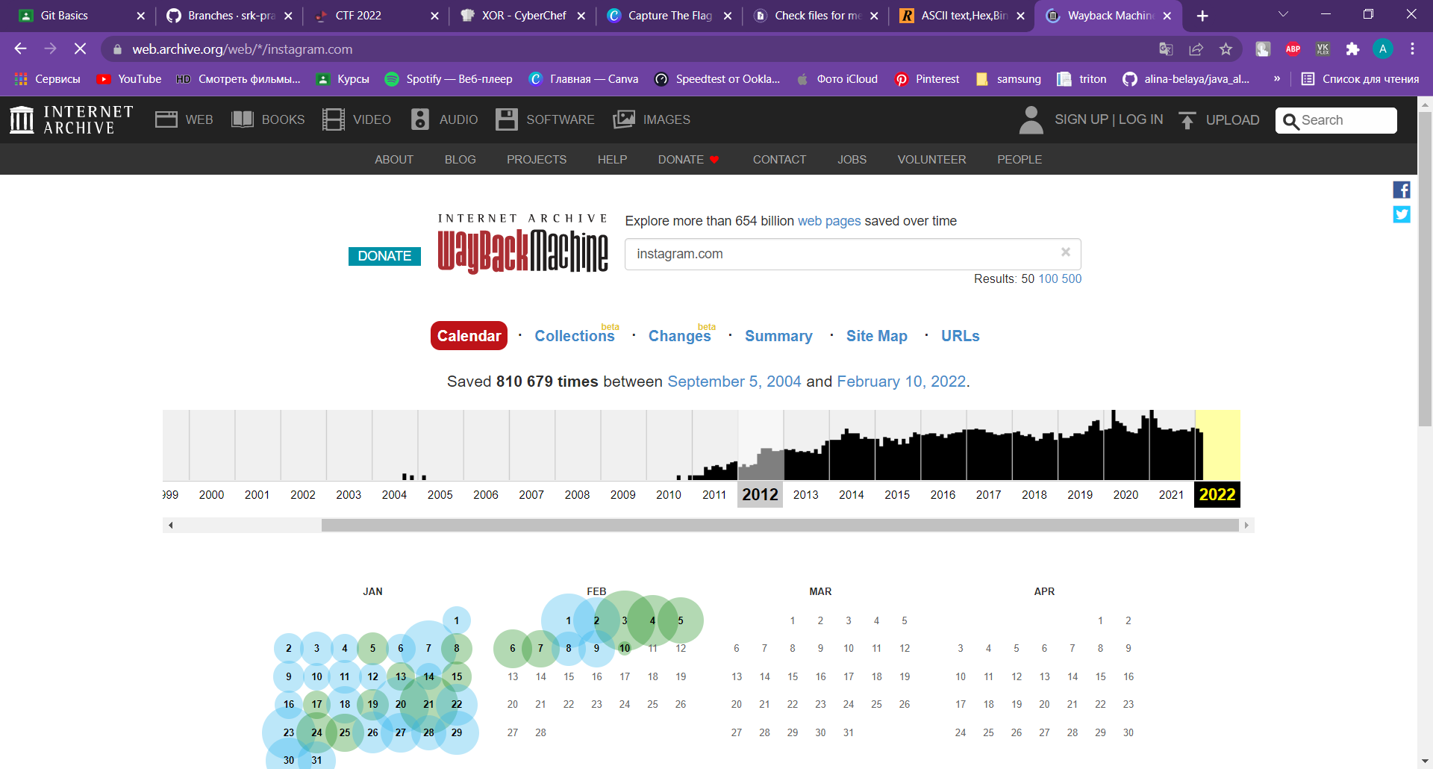
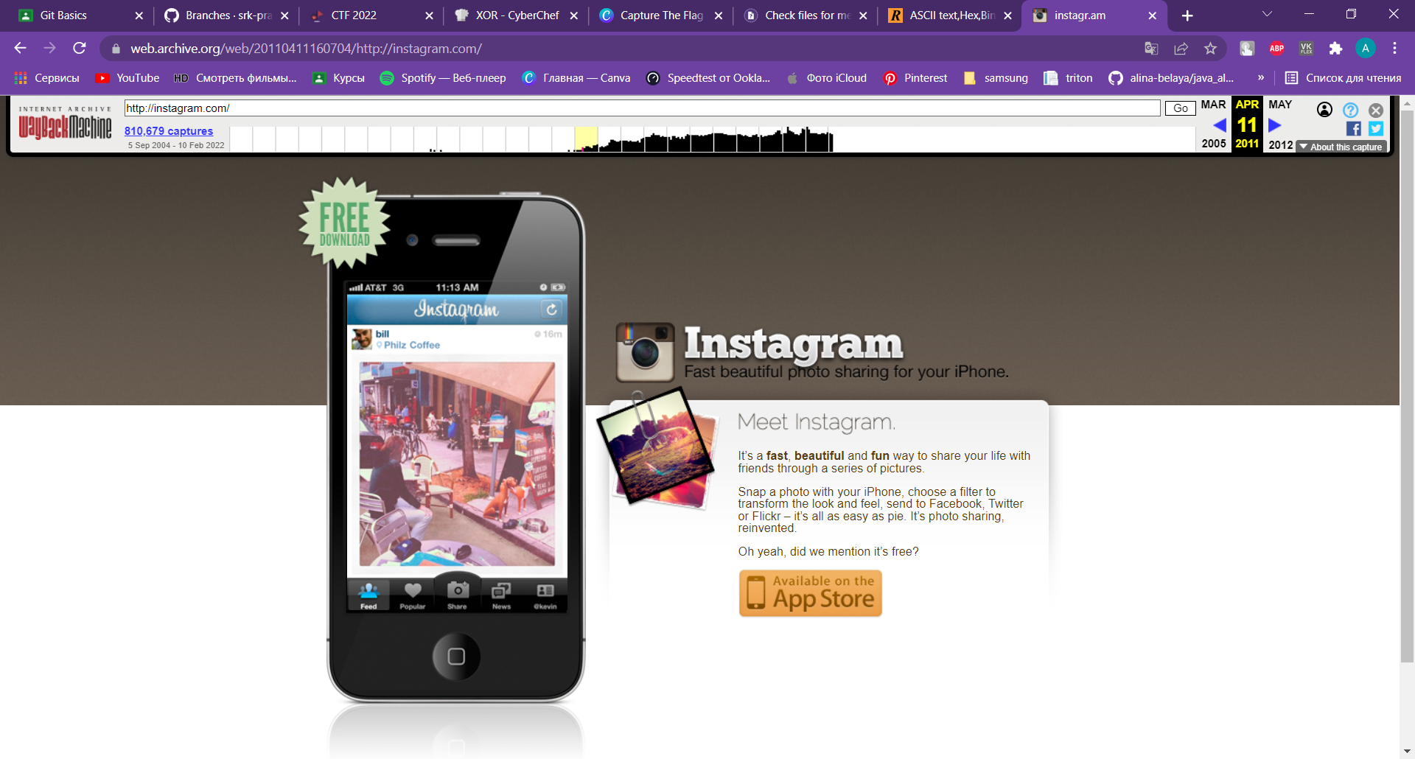
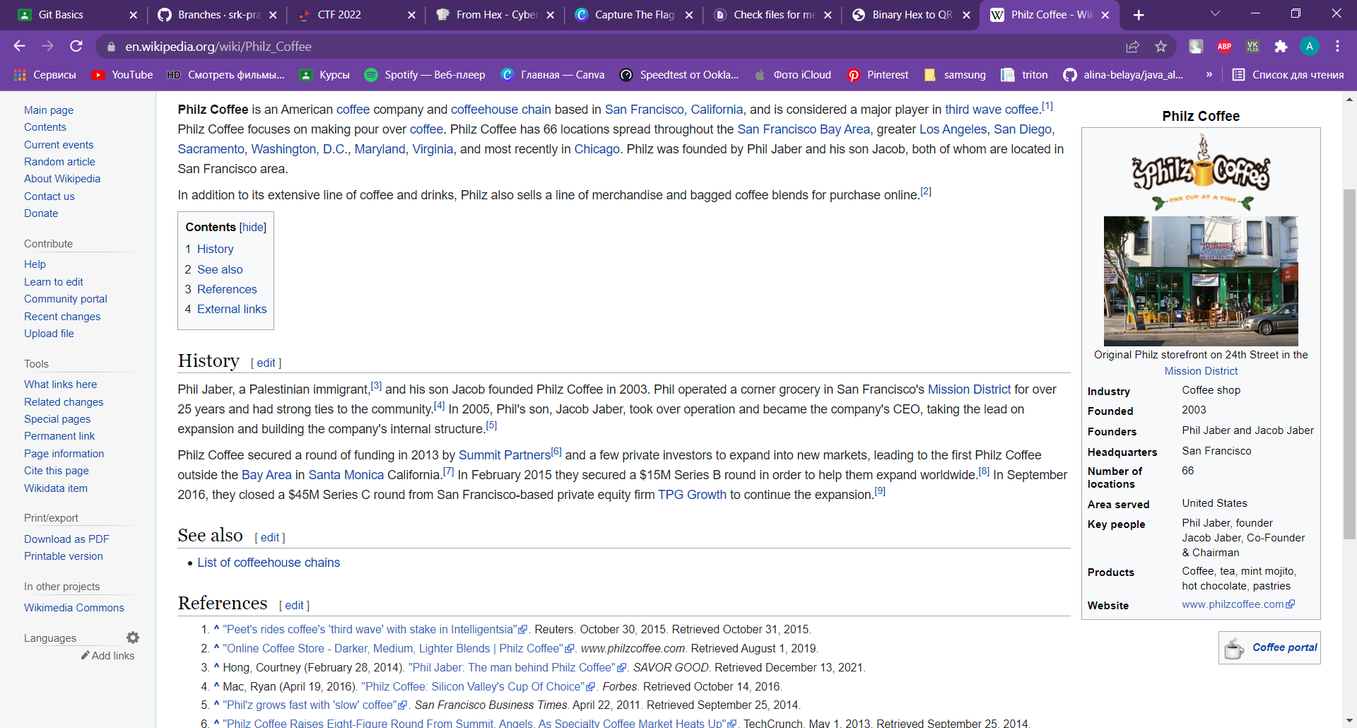

CEO
OSINT

Slide 6
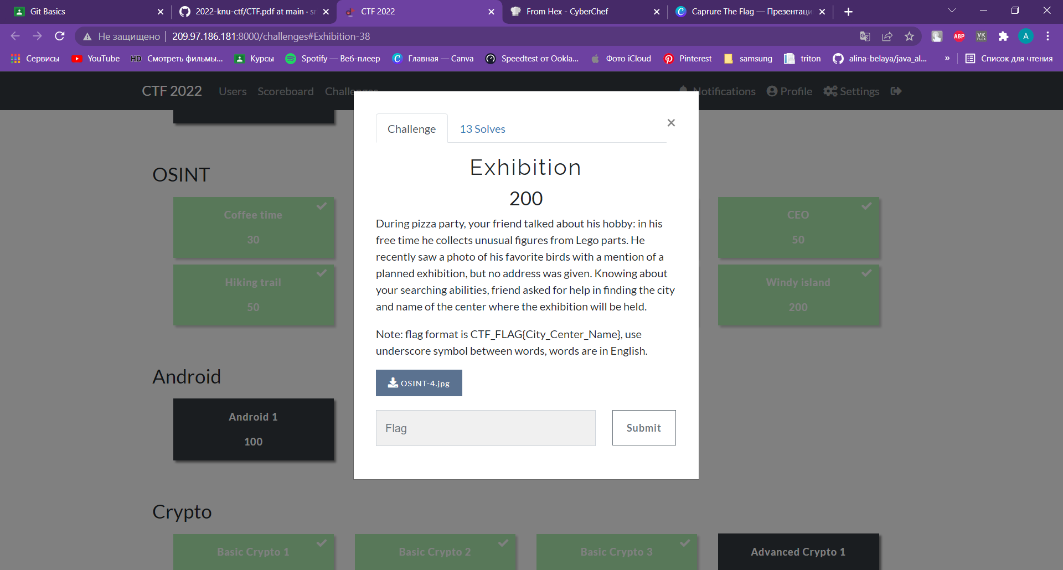
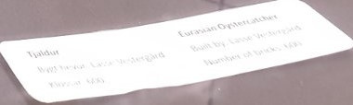
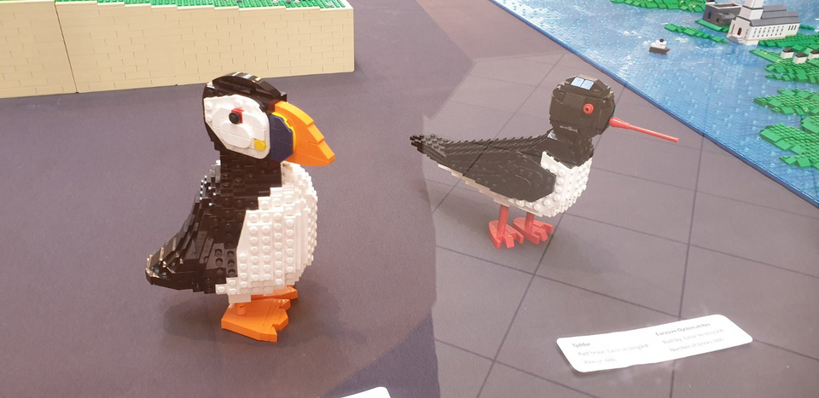
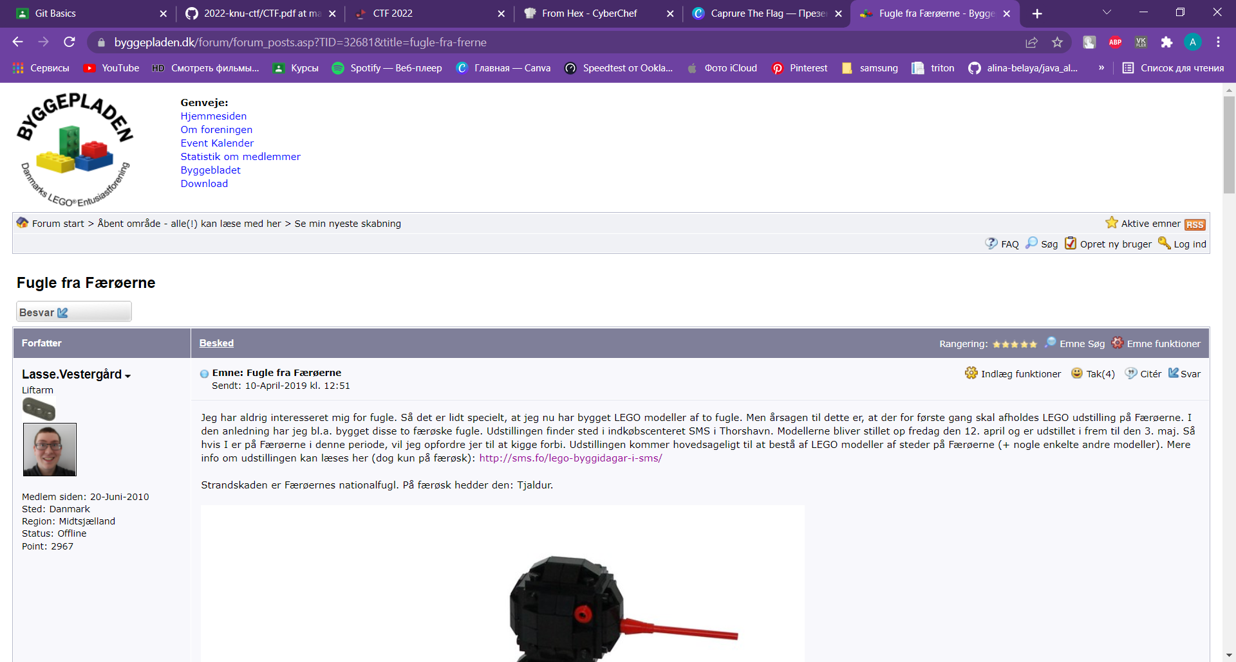

Exhibition
OSINT

Slide 7
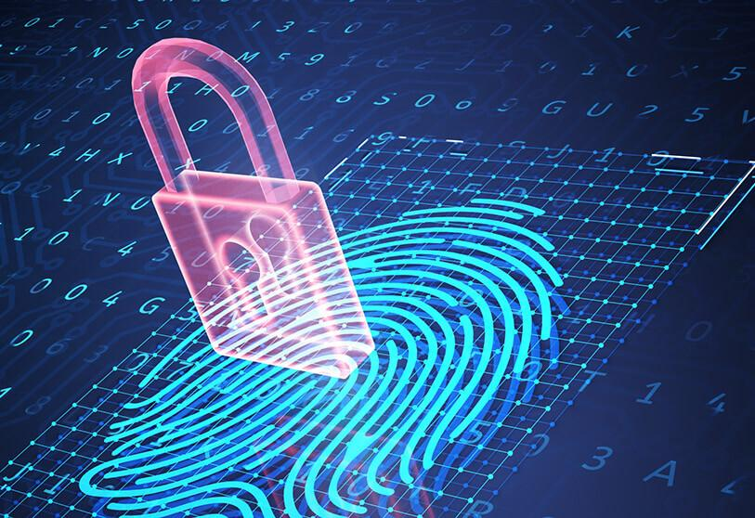
Crypto
Cryptography is the study of secure communications techniques that allow only the sender and intended recipient of a message to view its contents.
In the case of CTFs, the goal is usually to crack or clone cryptographic objects or algorithms to reach the flag.

Slide 8
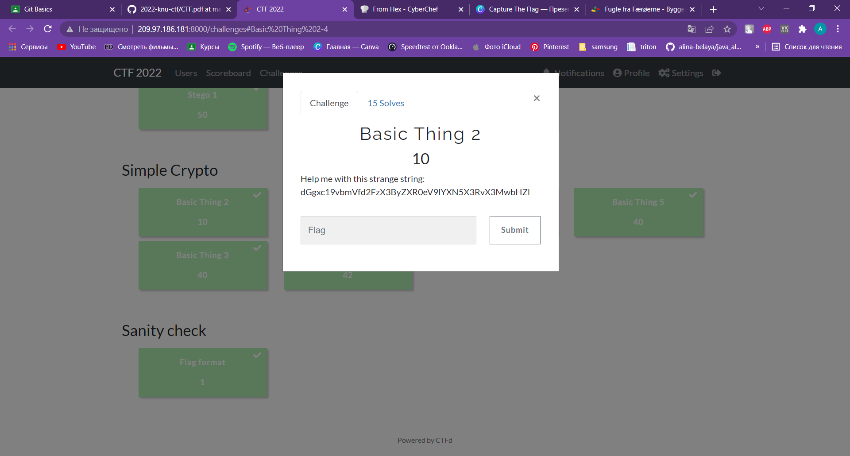
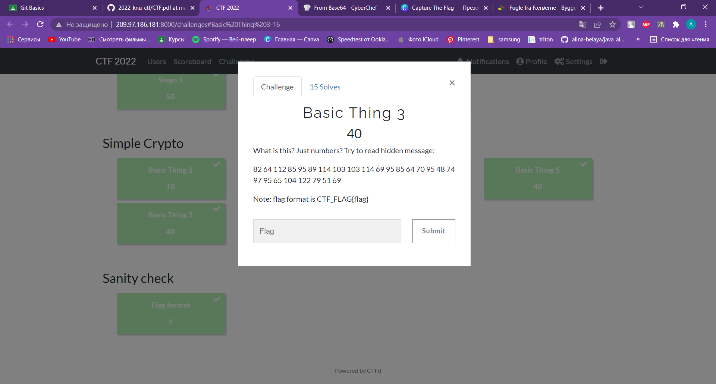

Basic Thing 2
Basic Thing 3
Base64
Decimal
+
ROT13
th1s_one_was_pretty_easy_to_s0lve
E@cH_LetteR_H@S_0Wn_NumB3R
Simple Crypto

Slide 9
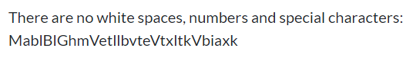
Basic Crypto 1
Caesarian Shift rot7
ThisIsNotClassicalCaesarCipher
Crypto

Slide 10
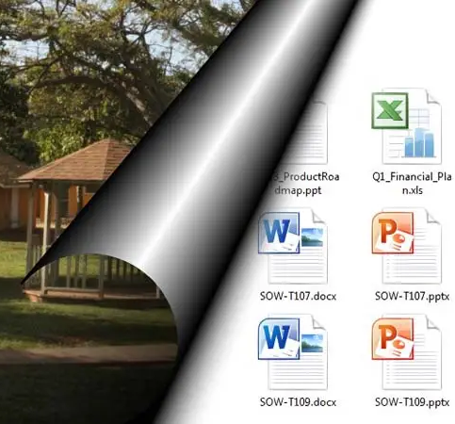
Stego
Steganography is the art or practice of concealing a message, image, or file within another message, image, or file.
In the context of CTFs steganography usually involves finding the hints or flags that have been hidden with steganography.

Slide 11
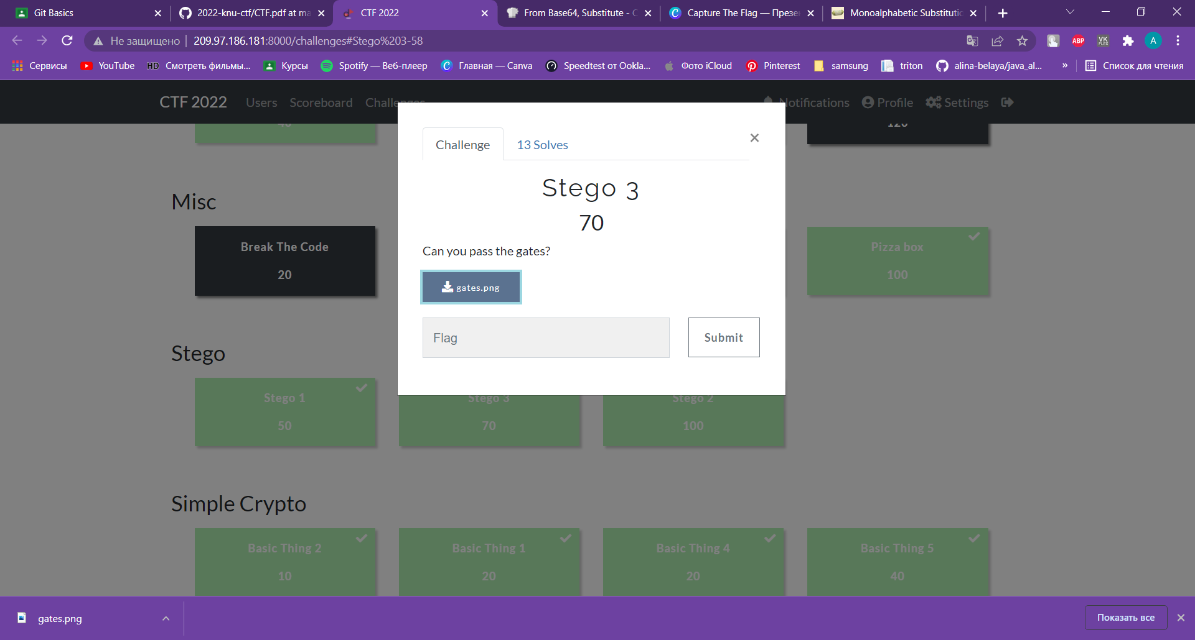
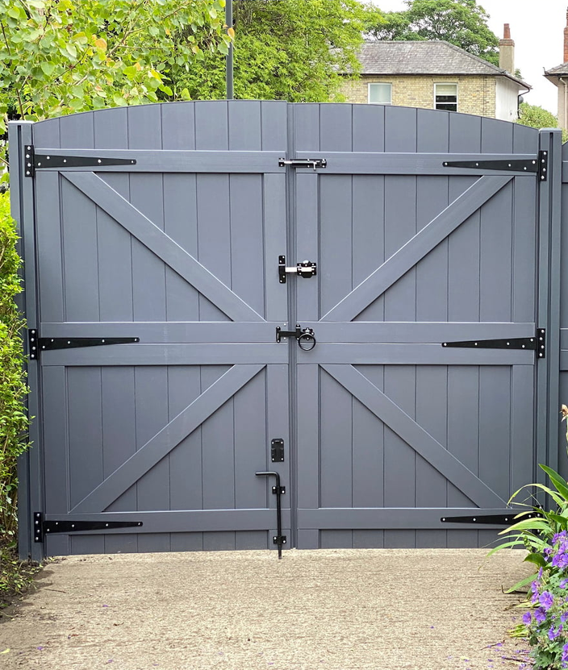
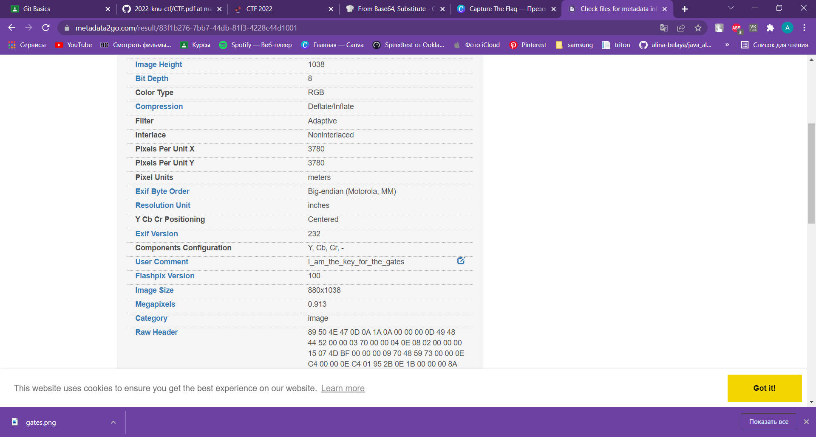

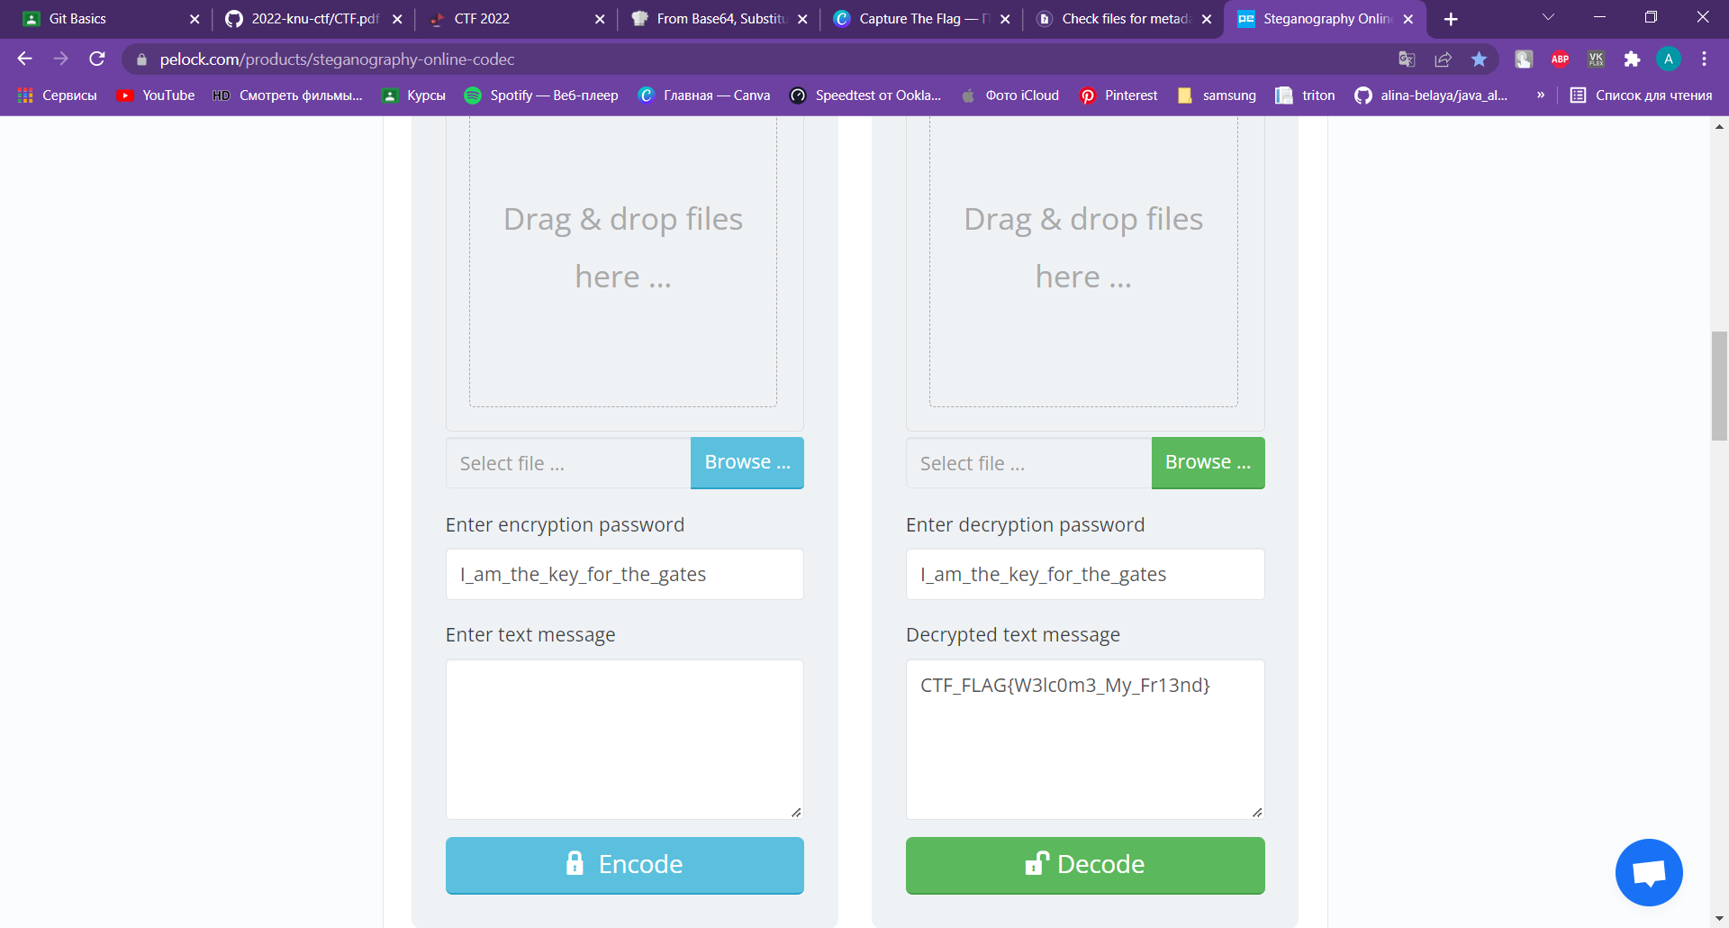
Stego 3
Metadata
Stego

Slide 12
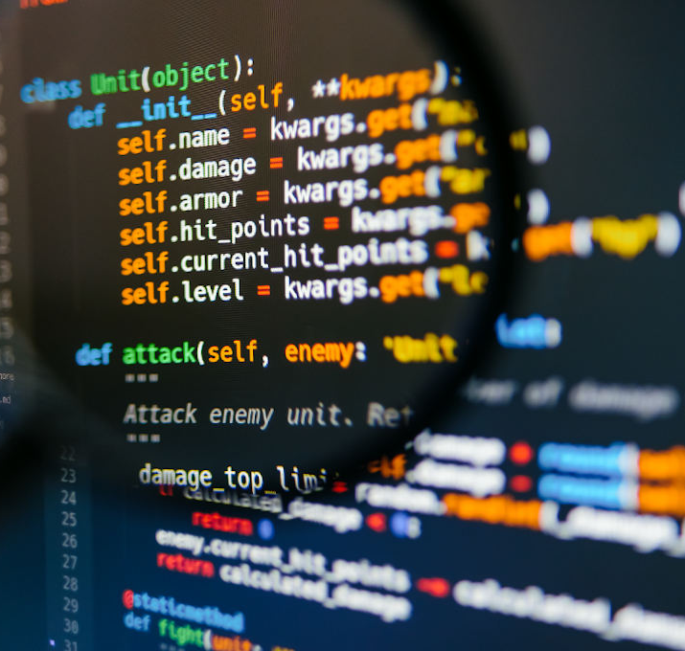
Misc
Many challenges in CTFs will be completely random and unprecedented, requiring simply logic, knowledge, and patience to be solved. There is no sure-fire way to prepare for these, but as you complete more CTFs you will be able to recognize and hopefully have more clues on how to solve them.

Slide 13
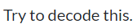
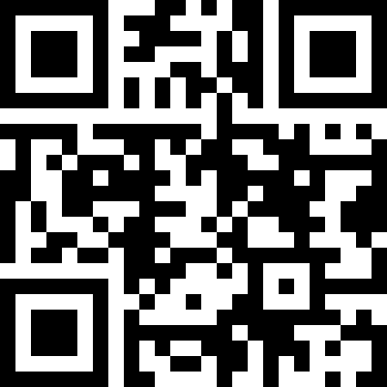
Symbols Can Pretend
1111111000110101101111111
1000001011100001101000001
1011101001111010101011101
1011101011000010101011101
1011101000011011101011101
1000001010101101101000001
1111111010101010101111111
0000000000000010000000000
1111101111111011110101010
0100100011010110011100001
0101011101001111001111111
1100110111101011111010001
1100111111000011011110011
1010110001110010111100111
1010001011000101001110111
1001100111100011000100010
1011011011011101111111001
0000000011110010100010001
1111111010100000101011111
1000001001001001100010000
1011101010000011111111010
1011101011111110111000111
1011101010100111011101001
1000001010011011010100001
1111111011000010010001011
CTF_FLAG{QR_C0d3_IS_S0_S1mpl3}
Misc

Slide 14
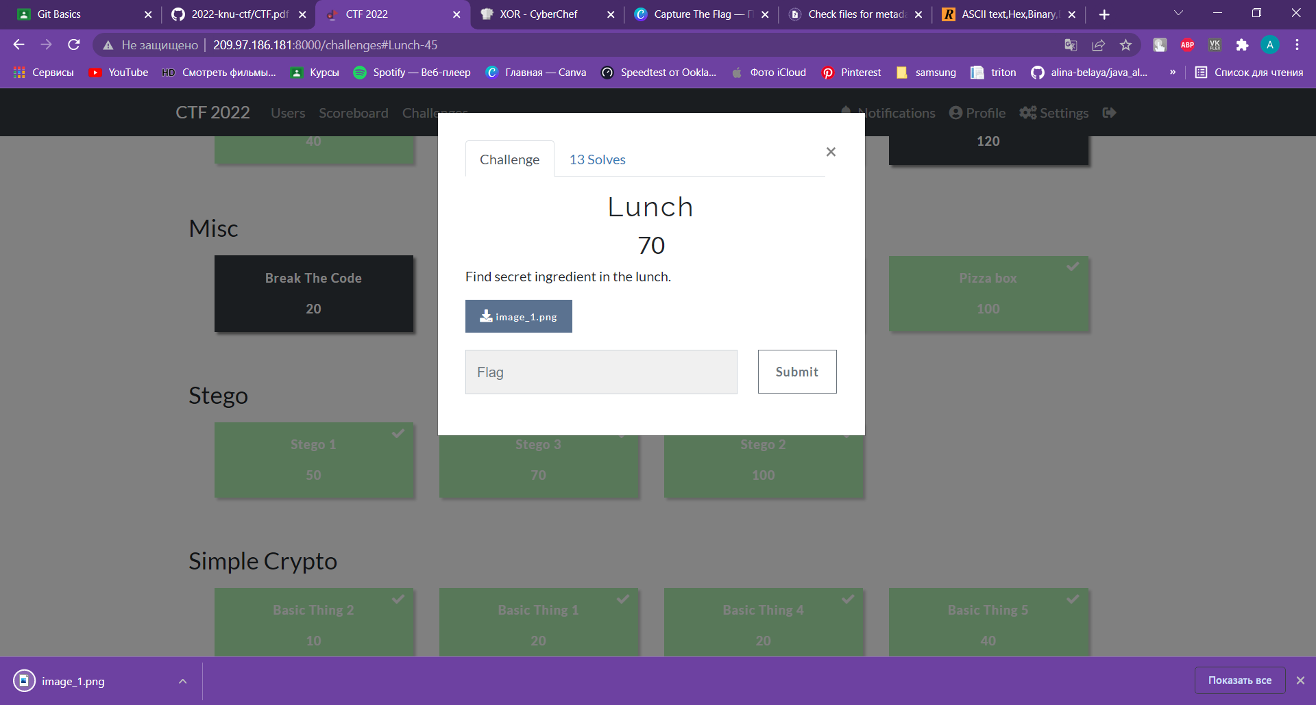

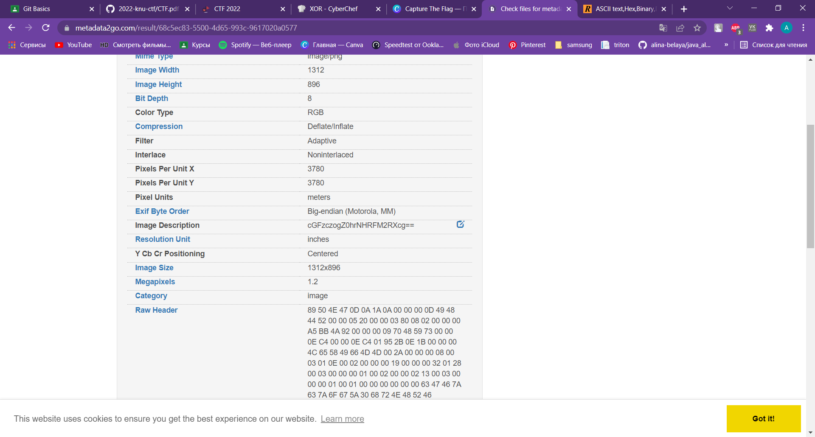
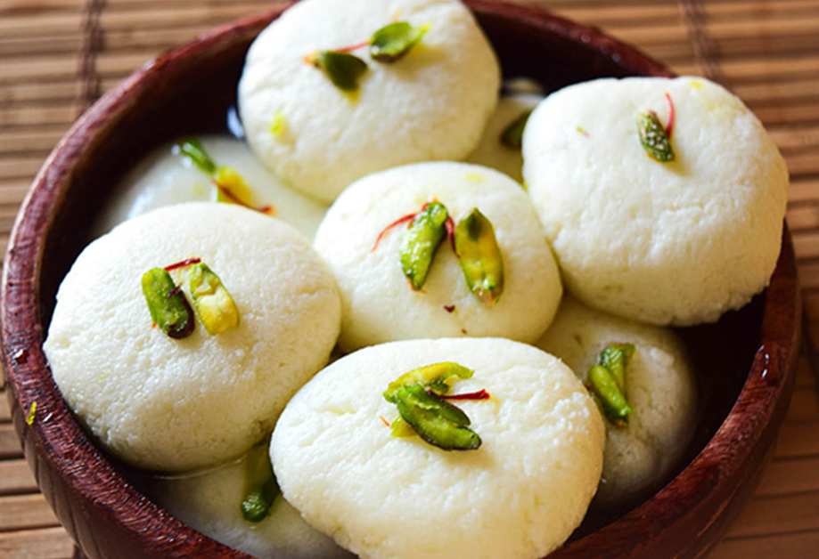
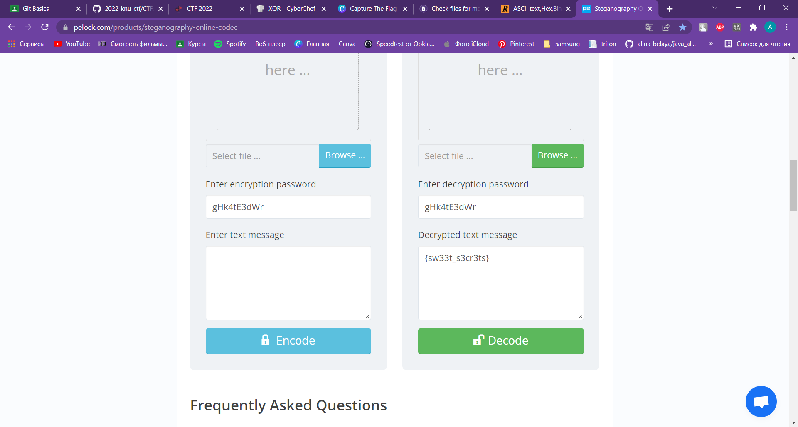
Lunch
Base64
pass: gHk4tE3dWr
Metadata
Misc

Slide 15
QUICK LOOK INTO CRYPTOGRAPHY, STEGANOGRAPHY, OSINT, RE ETC
COMMUNICATION SKILLS
Achievments
EXPERIENCE IN SOLVING DIFFERENT CTF TASKS
THINKING IN AN ORIGINAL WAY
IMPROVED SEARCHING SKILLS

Slide 16
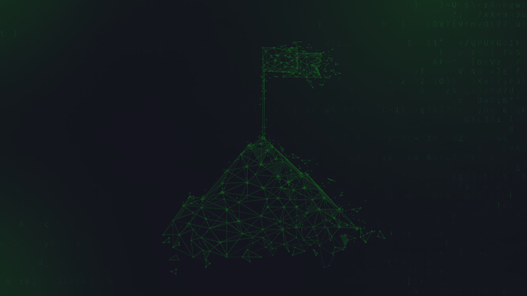
Thank you for attention

